Slide 1
Masked Patches 3 class
Anshuman Singh
5431362

Slide 2
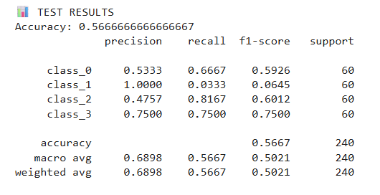
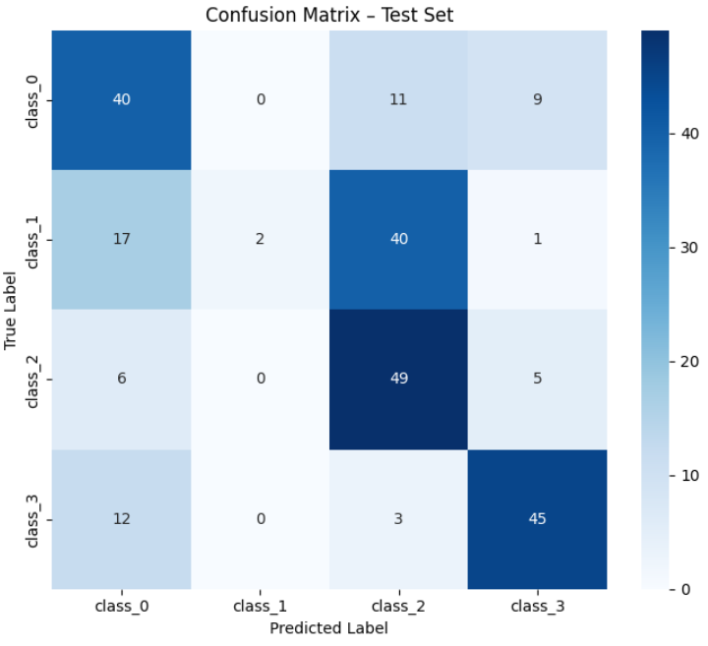
Previous Results from CNN model for 4 class
class_names = ["Slate", "Clay", "Cement", "Flat_roof_coverings"]

Slide 3
Possible reasons for failure cases in 4 class classification
Shape and Height that means not flat roof covering.
Many clay are classified as cement.
Problem in Ground truth data-(Flat roof covering has wrong image)
Two roof in a single image.(Possibilities in vector data)
Very Challenging samples (roof cannot visible has many solar panels) Flat roof covering

Slide 4
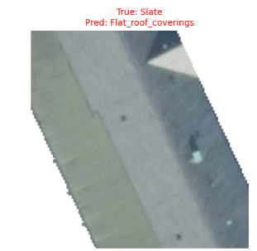
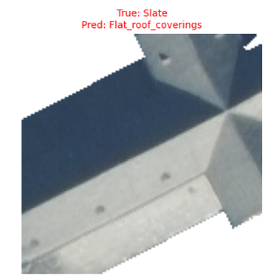
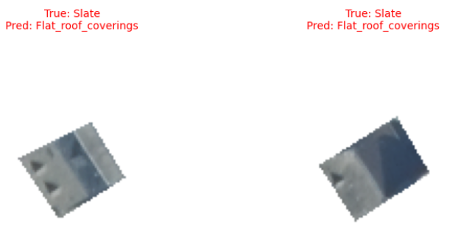
Classification Results 4 class
Shape and Height that means not flat roof covering.

Slide 5
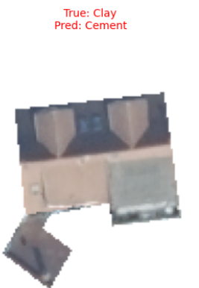
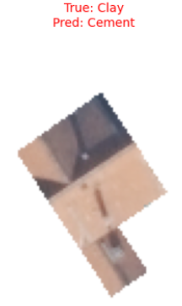
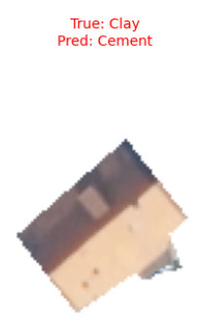
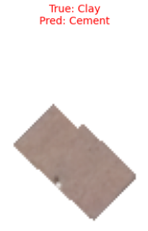
Classification Results
Many clay are classified as cement.

Slide 6
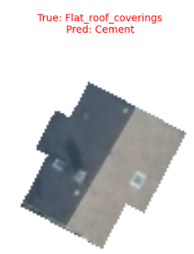
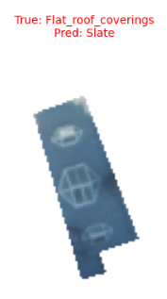
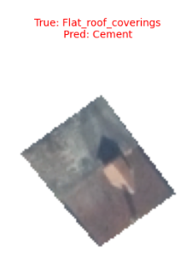
Classification Results
4. Problem in Ground truth data-(Flat roof covering has wrong image)

Slide 7
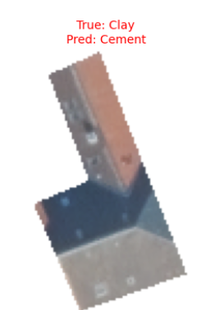
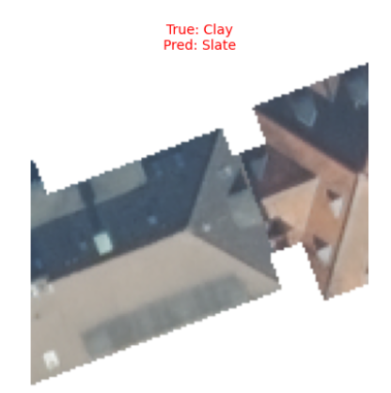
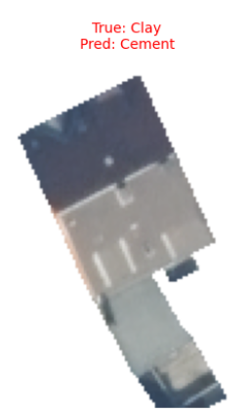
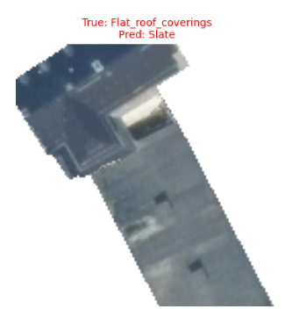
Classification Results
5. Two roof in a single image.(Possibilities in vector data)

Slide 8
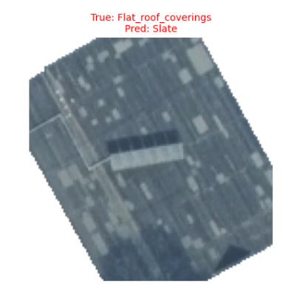
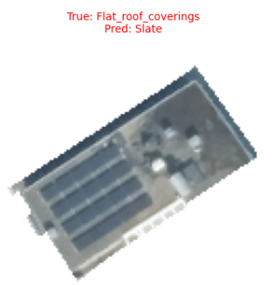
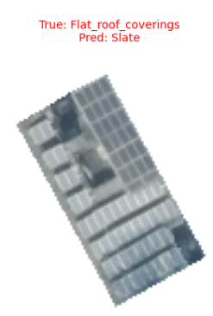
Classification Results
6. Very Challenging samples (roof cannot visible has many solar panels) Flat roof covering

Slide 9
For 3 class classification
I added squeeze and excitation in the code of CNN to find which feature maps (channels) are important for the image, and which should be suppressed.
In addition, I also added Label smoothing to allow some misclassification and found the value of 0.01 to be perfect for 3 class classification after experimenting with different values.

Slide 10
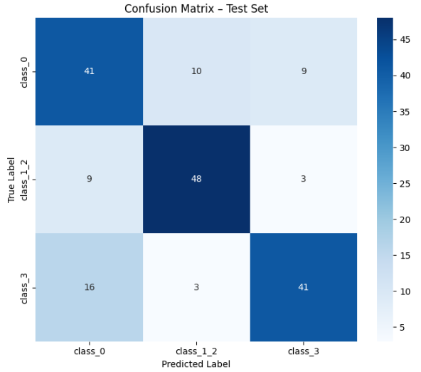
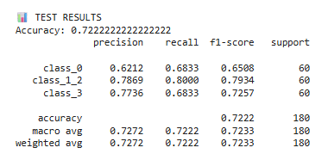
3 class classification results
class_names = ["Slate", "Clay_or_Cement", "Flat_roof_coverings"]

Slide 11
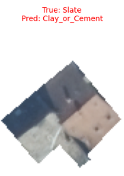
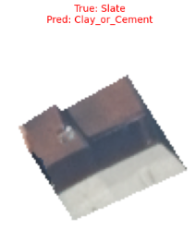
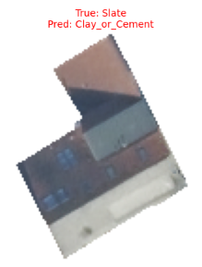
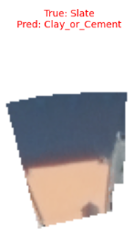
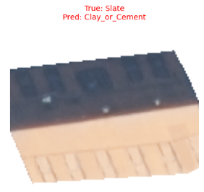
Failure cases for 3 class classification
There are some images in Slate which are yellowish/Orange and hence are classified as Clay_Cement class. Also looks like two roof in single image.

Slide 12
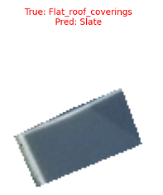
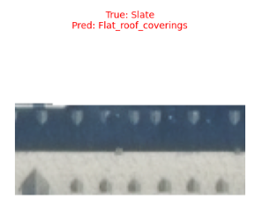
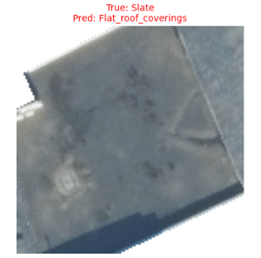
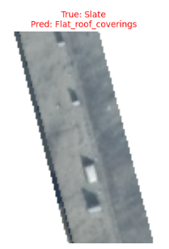
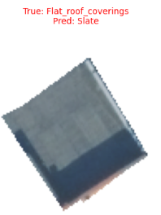
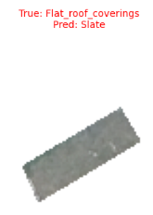
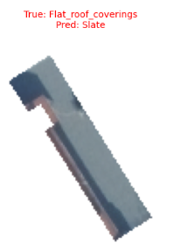
Failure cases for 3 class classification
2. Because of the same image colour of being greyish/black in slate and Flat roof covering. Some images in slate are classified as Flat Roof Coverings and vice versa.

Slide 13
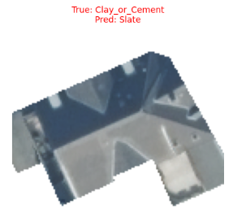
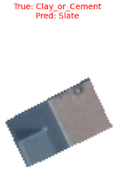
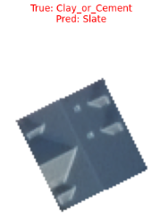
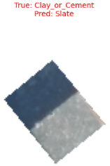
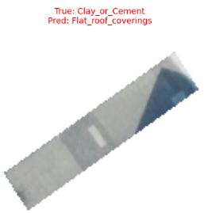
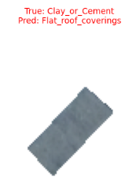
Failure cases for 3 class classification
3. Because some of the images in Clay_Cement have greyish image so the model is classifying them as slate or Flat Roof Coverings

Slide 14
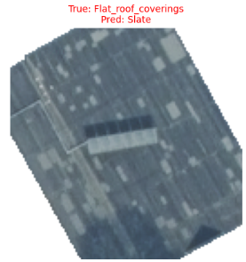
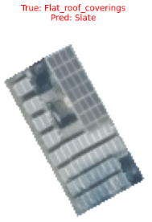
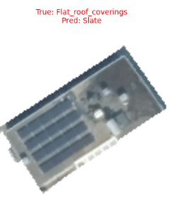
Failure cases for 3 class classification
Samples are still challenging they have solar panels on roof.

Slide 15
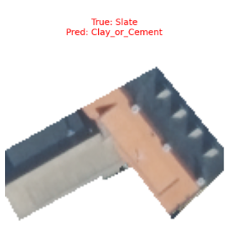
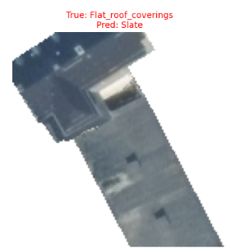
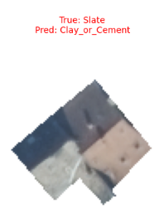
Failure cases for 3 class classification
5. Still two roofs in a single image.

Slide 16
Conclusion for 3 class classification
Model is learning the colour - Slate and Flat_roof_coverings are mostly gray and black while Clay and Cement are mostly Orange.
The double roof problem is minimized but not completely extinct as images are mostly classified based on its colour to the class.
Problem in Ground truth data-(Flat roof covering has wrong image) as in 4 class classification is still remain as it is because we have not changed the dataset.
But still the 3 class classification has given better results as compare to 4 class
Now , possible solution is to use the height information provided by Kerstin and proceed further to find out results.

